Slide 1
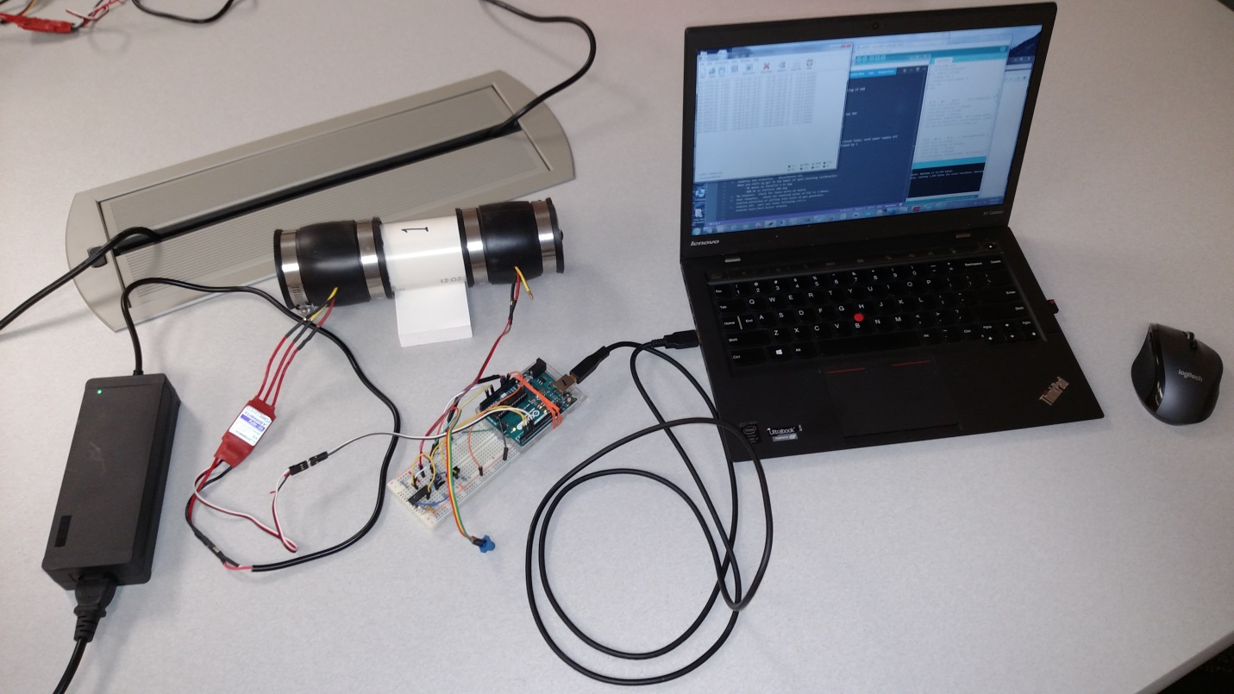
A-Course Controls Assignment “Controlling in the Wind” Photon Toolchain
Dave Gutz
April 2017

Slide 2
Summary
This installs utilities and drivers to compile Photon firmware and applications completely offline. It appears to not interfere with the normal particle cli process.

Slide 3
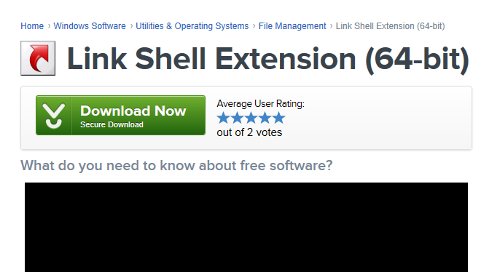
Step 0: Install link shell extension (LSE)
Makes it easy to modify Arduino code
Link to download:
http://download.cnet.com/Link-Shell-Extension-64-bit/3000-2248_4-75213087.html
Link to manual:
http://www.howtogeek.com/howto/16226/complete-guide-to-symbolic-links-symlinks-on-windows-or-linux/
Click here. It will make you restart explorer.

Slide 4
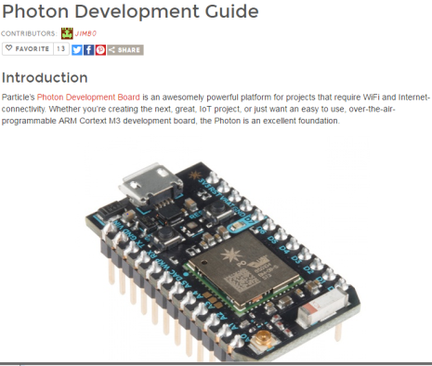
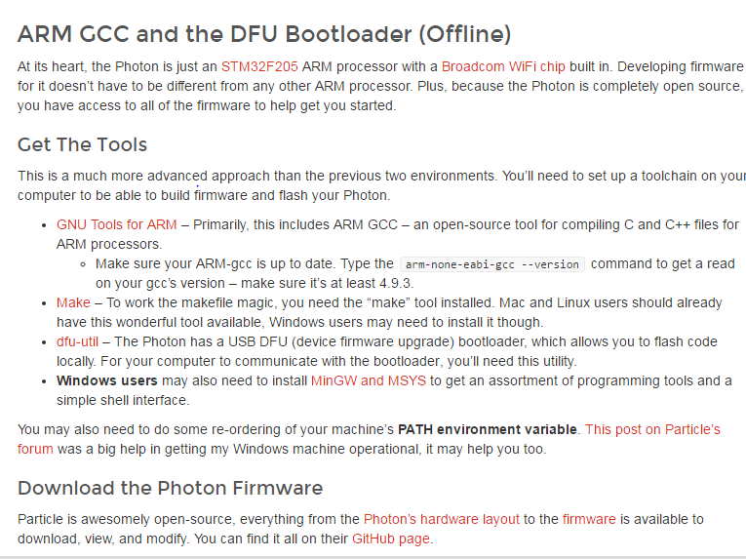
Reference Guide
https://learn.sparkfun.com/tutorials/photon-development-guide/all
Scroll down to ARM GCC and DFU Bootloader (Offline) for reference....
The following pages step through the setup of this offline process

Slide 5
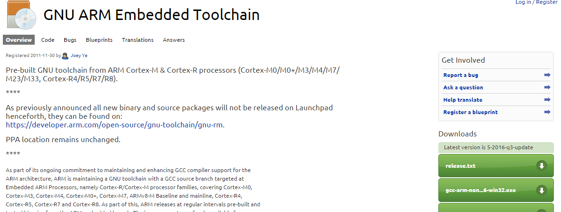
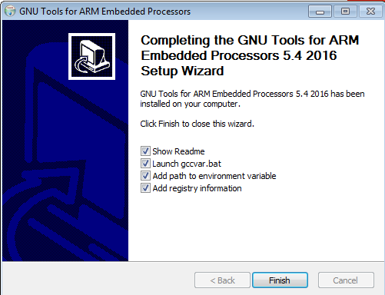
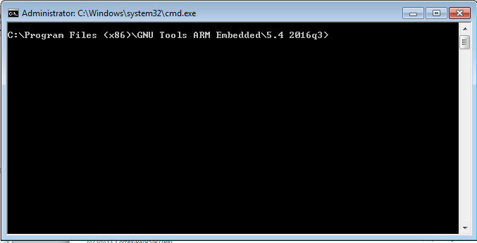
Step 1: Install GNU Tools for ARM
Needed to compile Photon
Link to download:
https://launchpad.net/gcc-arm-embedded
Click “Windows installer for admin install”
Click “Add path to environment variable”
Close this window by “X” ing it.

Slide 6
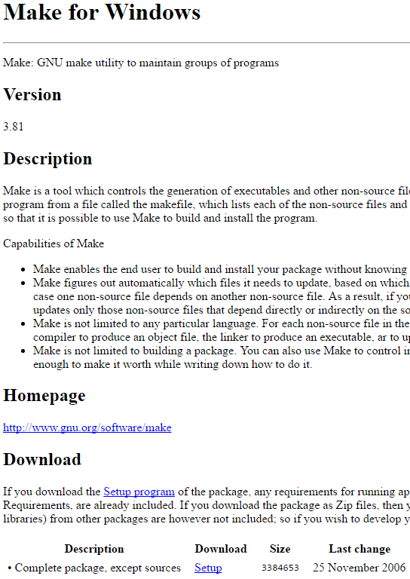
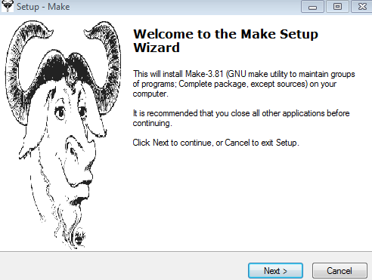
Step 2: Install Make for Windows
Needed to connect compiler to code
http://gnuwin32.sourceforge.net/packages/make.htm
Click “Setup” to download make-3.81.exe. Run as admin. Full installation, all defaults.
Successful install will finish without any notifications

Slide 7
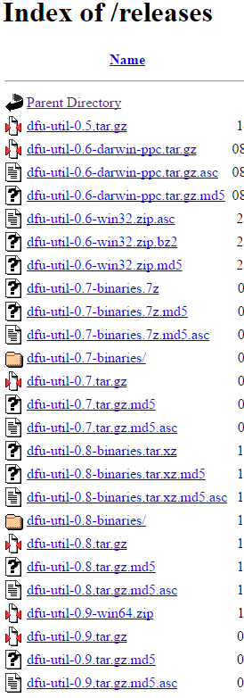
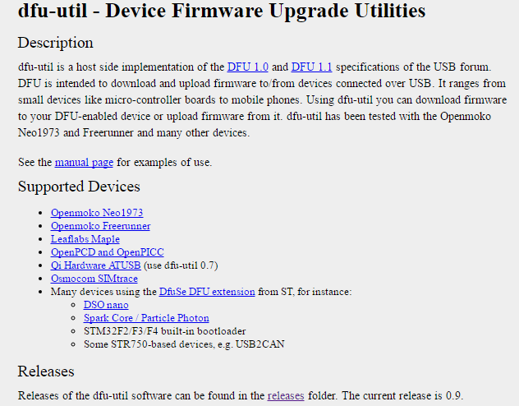
Step 3: Install dfu-util
?? Not sure this was even unzipped on laptop ??
Needed to talk to Photon
http://dfu-util.sourceforge.net/
Click “dfu-util-0.9-win64.zip”
Click “releases”

Slide 8
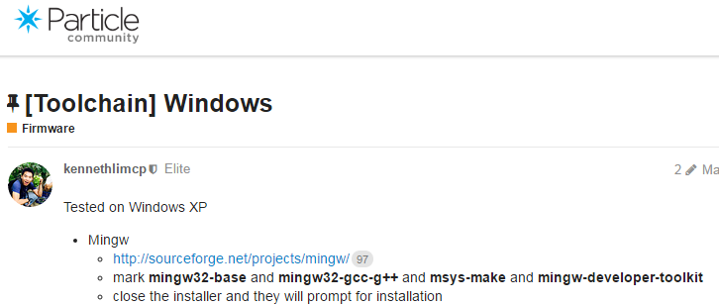
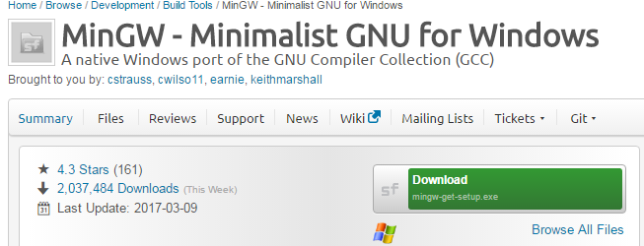
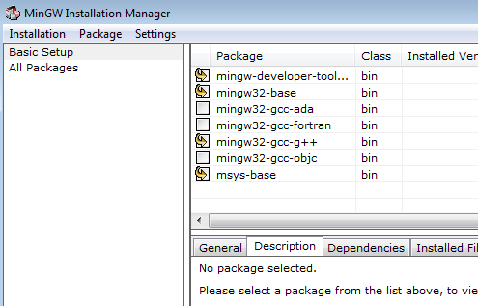
Step 4: Install MinGW
Windows Command Line Tools
https://community.particle.io/t/toolchain-windows/11635
Click “mingw” link
Click “download” for mingw-get-setup.exe. Open; all defaults.
Mark these 4 for installation.
Installation-Apply Changes
Then quit

Slide 9
Step 5: Modify Path in System Environment Variables
Windows Command Line Tools
C:\Program Files (x86)\GNU Tools ARM Embedded\4.9 2015q1\bin;C:\MinGW;C:\Program Files (x86)\GnuWin32\bin;C:\MinGW\msys\1.0\bin
original:
Latest:
C:\Program Files (x86)\CVSNT\;C:\Users\210023782\AppData\Local\particle\bin;C:\Users\210023782\AppData\Local\particledev\bin;C:\Program Files (x86)\Microsoft VS Code\bin;C:\Program Files (x86)\GNU Tools ARM Embedded\5.4 2016q3\bin;C:\Program Files (x86)\GnuWin32\bin;C:\MinGW\msys\1.0\bin;C:\Git\bin
On win10 (SEE NEXT PAGE)
C:\Particle\Tools\Git\bin

Slide 10
Windows 10 PATH
C:\Program Files (x86)\GNU Tools ARM Embedded\5.4 2016q3\bin C:\Users\Dave\AppData\Local\particle\bin C:\Users\Dave\AppData\Roaming\npm C:\Particle\Toolchain\Make\bin C:\Particle\Toolchain\MinGW C:\Particle\Toolchain\MinGW\msys\1.0\bin C:\Particle\Toolchain\GCC-ARM\bin C:\Particle\Tools\DFU-util C:\dfu-util-0.8-binaries\win32-mingw32 C:\Users\Dave\AppData\Local\Microsoft\WindowsApps C:\Program Files (x86)\Microsoft VS Code\bin C:\Users\Dave\AppData\Local\atom\bin C:\Program Files (x86)\GnuWin32\bin C:\MinGW\msys\1.0\bin C:\Particle\Tools\Git\bin

Slide 11
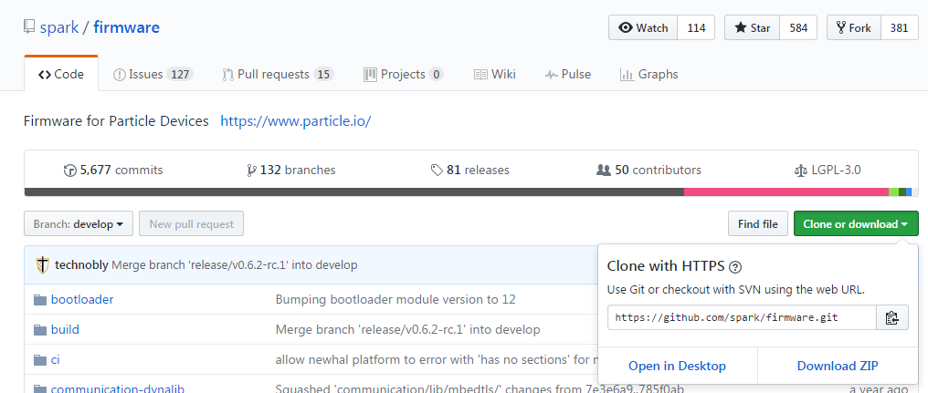
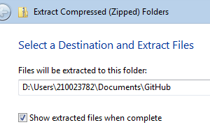
Step 6: Install Particle Firmware
Get the latest
https://github.com/spark/firmware
Click “Download ZIP”
If cloning get latest “release”
I got branch: “release/v0.6.2”
Xxx
“develop”
Extract to GitHub Folder

Slide 12
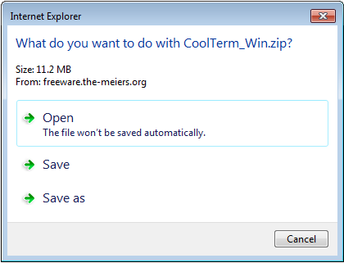
Step 7: Install CoolTerm USB
Link to install: http://freeware.the-meiers.org/CoolTerm_Win.zip
Unzip and copy “CoolTerm_0.stc” in this folder to the desktop for easy starting of USB

Slide 13
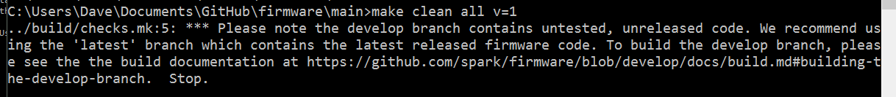
Step 8: Make Firmware
- Open cmd.exe as Administrator:
cd “Users\210023782\Documents\GitHub\firmware\main”
Or
cd “C:\Users\<name>\Documents\GitHub\firmware-develop\main” #for Win10
make clean all v=1
***If command not found, PATH not correct. Correct and restart cmd.exe
- Make will complain about “git not found” but will compile anyway.
- This takes about 10 minutes, 2 minutes in Win 10 with a SSD.
***The following message means you did not clone the latest release. Go back to the Install Particle Firmware step.

Slide 14
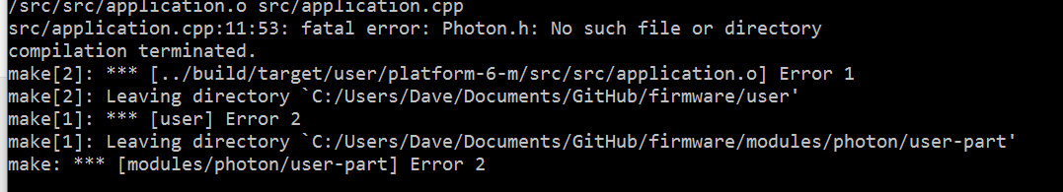
FAQ
***This message means you installed wrong version of firmware from github

Slide 15
Step 9: Install myWindCode
Using Windows Explorer copy myWindCode folder to GitHub\firmware\user\applications
Or GitHub\firmware-develop\user\applications
You could use Link Shell Extension to link the folder
right click on GitHub\Wind\myWindCode
pick link source
browse to GitHub\firmware\user\applications
drop as symbolic link
If needed, using your favorite editor, add the line:
#include <Particle.h>
after the line #include “application.h”
The application must have suffix “.cpp” e.g. myWindCode.cpp

Slide 16
Redo Loop
make PLATFORM=photon APP=blink program-dfu
With photon in dfu mode go to main folder using cmd as administrator
cd ../../Users/210023782/Documents/GitHub/firmware/main
cd ../../Users/Dave/Documents/GitHub/firmware/main
cd ../../Users/Dave/Documents/GitHub/firmware-develop/main
make all PLATFORM=photon APP=myWindCode
make PLATFORM=photon APP=myWindCode program-dfu
dfu-util -d 2b04:d006 -a 0 -i 0 -s 0x80A0000:leave -D ../build/target/user-part/platform-6-m/myWindCode.bin
--or--
make all program-dfu PLATFORM=photon APP=myWindCode
make clean all program-dfu PLATFORM=photon APP=myWindCode
Super Clean Redo Loop
Get the newest firmware from origin/develop using GitHub
go into the modules folder, and run w/ the Photon in dfu mode
make clean all program-dfu PLATFORM=photon
The two system firmwares will be updated, and then the user firmware. Will complain about git.
Modify user\src\application.cpp for your code
Go into the main folder, and run stuff above
cd ..\main

Slide 17
Visual Studio IDE
With this method, the Visual Studio Code process that calls ‘particle’ will not work. The compiler never finds the main.cc file.
To make the old process work, need myWindCode.ino or myWindCode.cpp application file without the #include “main.h” line.

